Slide 1
_{Talker here}

Slide 2

_{Talker here}

Slide 4

Scrolling bars

Slide 5
Mutil_work
possible

Slide 7
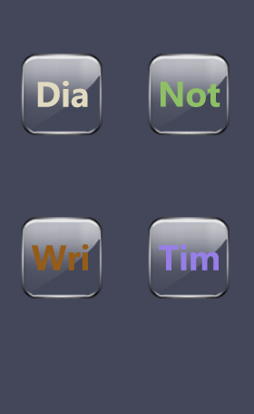
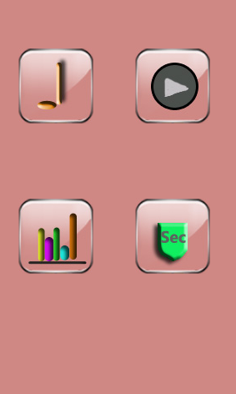
Software center

Slide 8
Entend
Strong

Slide 10
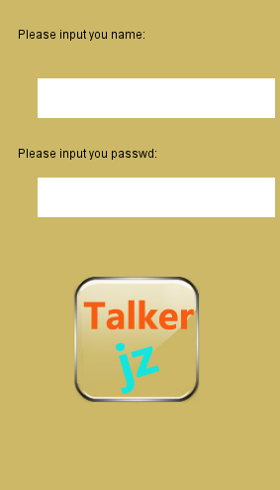
Security

Slide 11
Safe
Powerful

Slide 12
Thank you

